Slide 1


Office of Technology Transfer
Review of No. 15066
Title: A Method for Maximizing Performance and Minimizing Power Consumption in Embedded Peripherals
OTT Reviewer: Casey Boutwell
Co-Manager : Raghav
Intern: Sneha
^{CONFIDENTIAL} North Carolina State University © 2014

Slide 2


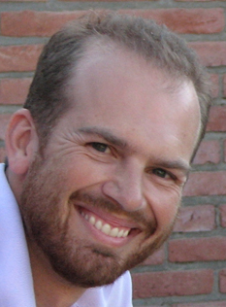
15066
Title: A method for maximizing performance and minimizing power consumption in embedded peripherals
Daniel R. Moore
Development Engineer
NCSU
Division: College of Engineering
Department : Electrical and Computer Engineering
Alexander G. Dean
Associate Professor
NCSU
Division: College of Engineering
Department : Electrical and Computer Engineering
^{CONFIDENTIAL} North Carolina State University © 2014
Notes:
Who was the sponsor of the research?
What are their rights, if any? Have they been notified?
Did the researchers make use of material obtained under an MTA?
If so, do we have obligations to the provider? Please describe.

Slide 3

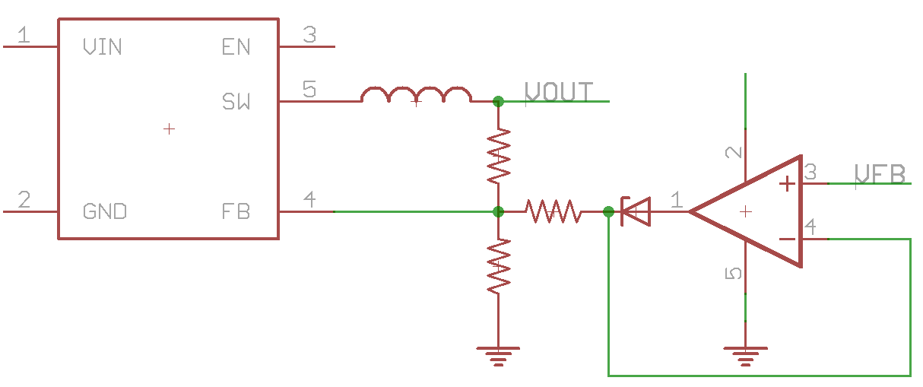
Executive Summary
This invention is designed to have minimal impact on CPU utilization through the use of peripheral power profiles (PPP) which designate an ideal voltage on a per-state basis.
This method is demonstrated on common peripherals and have found energy savings of up to 40%.
The method is applicable immediately with off-the-shelf parts, but will require the addition of a separate power supply for peripheral devices.
Some concerns about prior art.
Strategy: Accept management, engage with Elster Group to determine obligations, market non-confidentially for three months to gauge industry interest.

Slide 4

Technology Overview - Background
The key product differentiator in an embedded system is its power efficiency because lower power consumption results in lower operating costs, lower fan noise, and lower cooling requirements.
The closest state of art for this technology is the existing dynamic power management solution.
Dynamic Power Management identifies low processing requirement periods and reduces operating voltage (voltage scaling) and frequency (frequency scaling), resulting in reduced average operating power consumption. Like putting a hard drive to sleep.
But there are a few issues with DPM
Operating voltage and frequency scaling latency.
Processors may not operate reliably during voltage or frequency transition.
CPUs with integrated PLLs usually generate the required frequency for the integrated peripherals and also provide the clock for the external bus interface.
^{CONFIDENTIAL} North Carolina State University © 2014
Notes:
4

Slide 5
Technology Overview
This invention is designed to have minimal impact on CPU utilization through the use of peripheral power profiles (PPP) which designate an ideal voltage on a per-state basis.
Any peripheral operation seamlessly flows through the pre-determined states and the supply voltage is modulated automatically upon each transition.
Peripheral power profiles are unique in that during high-performance states such as data-transmission, peripherals can have the high supply voltage they demand.
I.e. we are not balancing between getting the best performance for the power we are allotted, we’re always getting best performance and optimum power.
Likewise, during low-performance states such as mandatory delays, the system can decrease domain voltage and thus reduce power consumption intra-operation.
^{CONFIDENTIAL} North Carolina State University © 2014

Slide 6
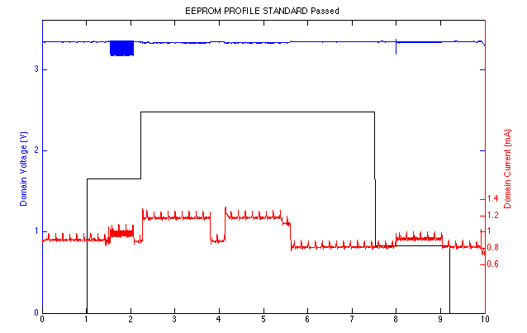
Technology Overview: Results
^{CONFIDENTIAL} North Carolina State University © 2014

Slide 7

Technology Overview - Advantages
The method is demonstrated on common peripherals and have found energy savings of up to 40%.
Battery powered and renewable systems would benefit from the energy savings and experience longer operating life.
Resistor, diode, and opamp help to regulate Vout from the Switched-Mode Power Supply (SMPS)

Slide 8
Technology Overview: Potential Applications
Any peripheral that has performance coupled to voltage can be scaled to take advantage of the method using off-the-shelf parts.
Low cost systems would benefit because the average load of the system would decrease and therefore power-failure circuits could use decreased charge-storage devices to in order to recover from power failures.
^{CONFIDENTIAL} North Carolina State University © 2014

Slide 9

Inventorship Issues
Dan Moore works at a metering company, Elster Group
OTT will engage with Elster to understand the obligations around their patent agreement and if the work is related to their internal R&D
^{CONFIDENTIAL} North Carolina State University © 2014

Slide 10

Public Disclosure Issues
A paper is being submitted for RTAS conference. The acceptance notification is due on December 13th, 2014.
^{CONFIDENTIAL} North Carolina State University © 2014
Notes:
Has an enabling public disclosure been made?
If so, how long do we have to seek protection?

Slide 11
Funding/MTA Issues
Gift Funds: Equipment costs paid for by co-inventor, Daniel Moore.
^{CONFIDENTIAL} North Carolina State University © 2014
Notes:
Who was the sponsor of the research?
What are their rights, if any? Have they been notified?
Did the researchers make use of material obtained under an MTA?
If so, do we have obligations to the provider? Please describe.

Slide 12
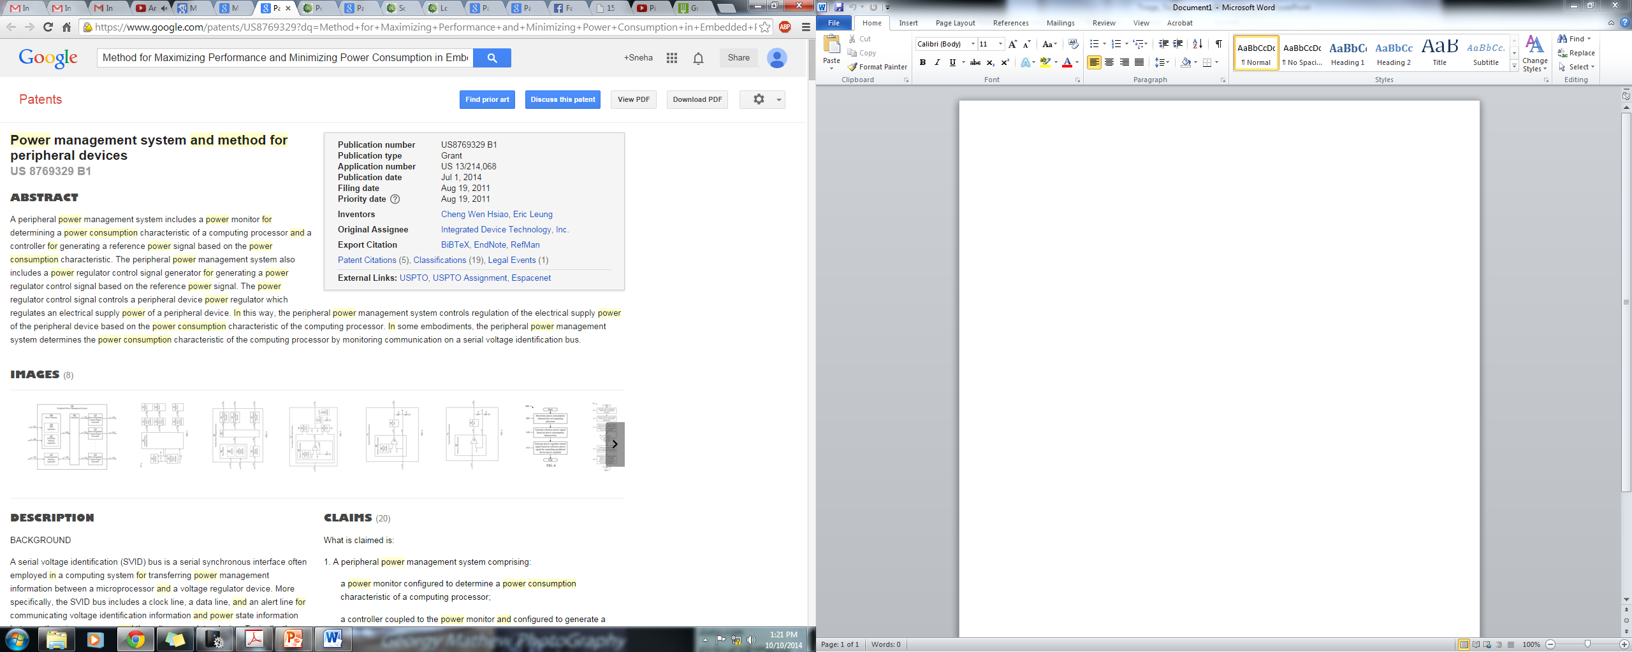
Prior Art Search
Keywords: Power management techniques for embedded systems, Peripheral devices power management techniques, Peripheral Power profile + Device Drivers.
Relevant patents/patent applications:
^{CONFIDENTIAL} North Carolina State University © 2014
Notes:
Any freedom to operate issues?
Any patentability issues?

Slide 13
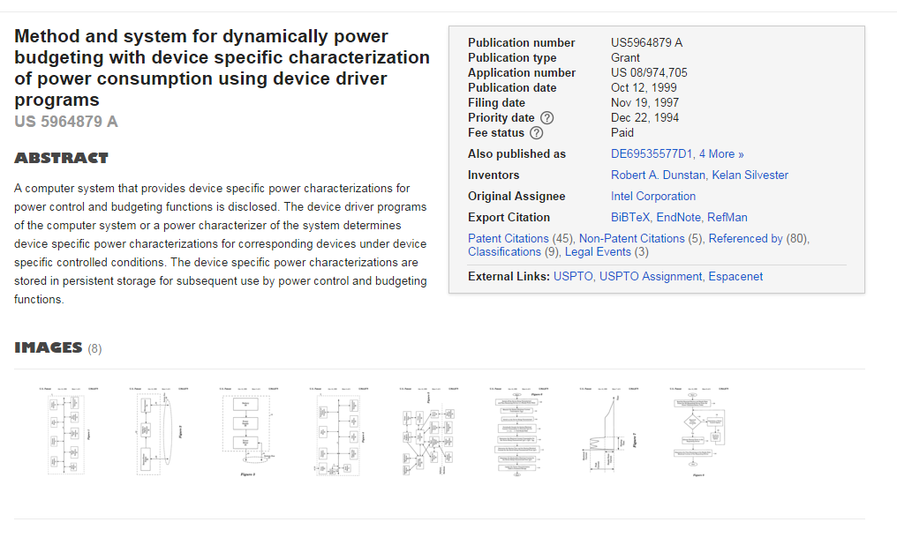
Prior Art Search
^{CONFIDENTIAL} North Carolina State University © 2014
Notes:
Any freedom to operate issues?
Any patentability issues?

Slide 14
Technology Development
The method can be achieved today with off-the-shelf parts. A System-on-Chip (SoC) or module could be developed that would optimize board-space considerations.
The module would take 6 months, the SoC would take 1 year.
^{CONFIDENTIAL} North Carolina State University © 2014
Notes:
Has the invention been reduced to practice?
How much additional development is needed to make the technology ready for marketing to potential licensees?
Does the inventor have the funding to accomplish this additional development?

Slide 15
Market Information
Microprocessor, GPU, and Peripherals Market is expected to grow at a CAGR of 7.49% from 2014 to 2020, and reach $128 billion in 2020.
^{CONFIDENTIAL} North Carolina State University © 2014
Notes:
Has the invention been reduced to practice?
How much additional development is needed to make the technology ready for marketing to potential licensees?
Does the inventor have the funding to accomplish this additional development?

Slide 16
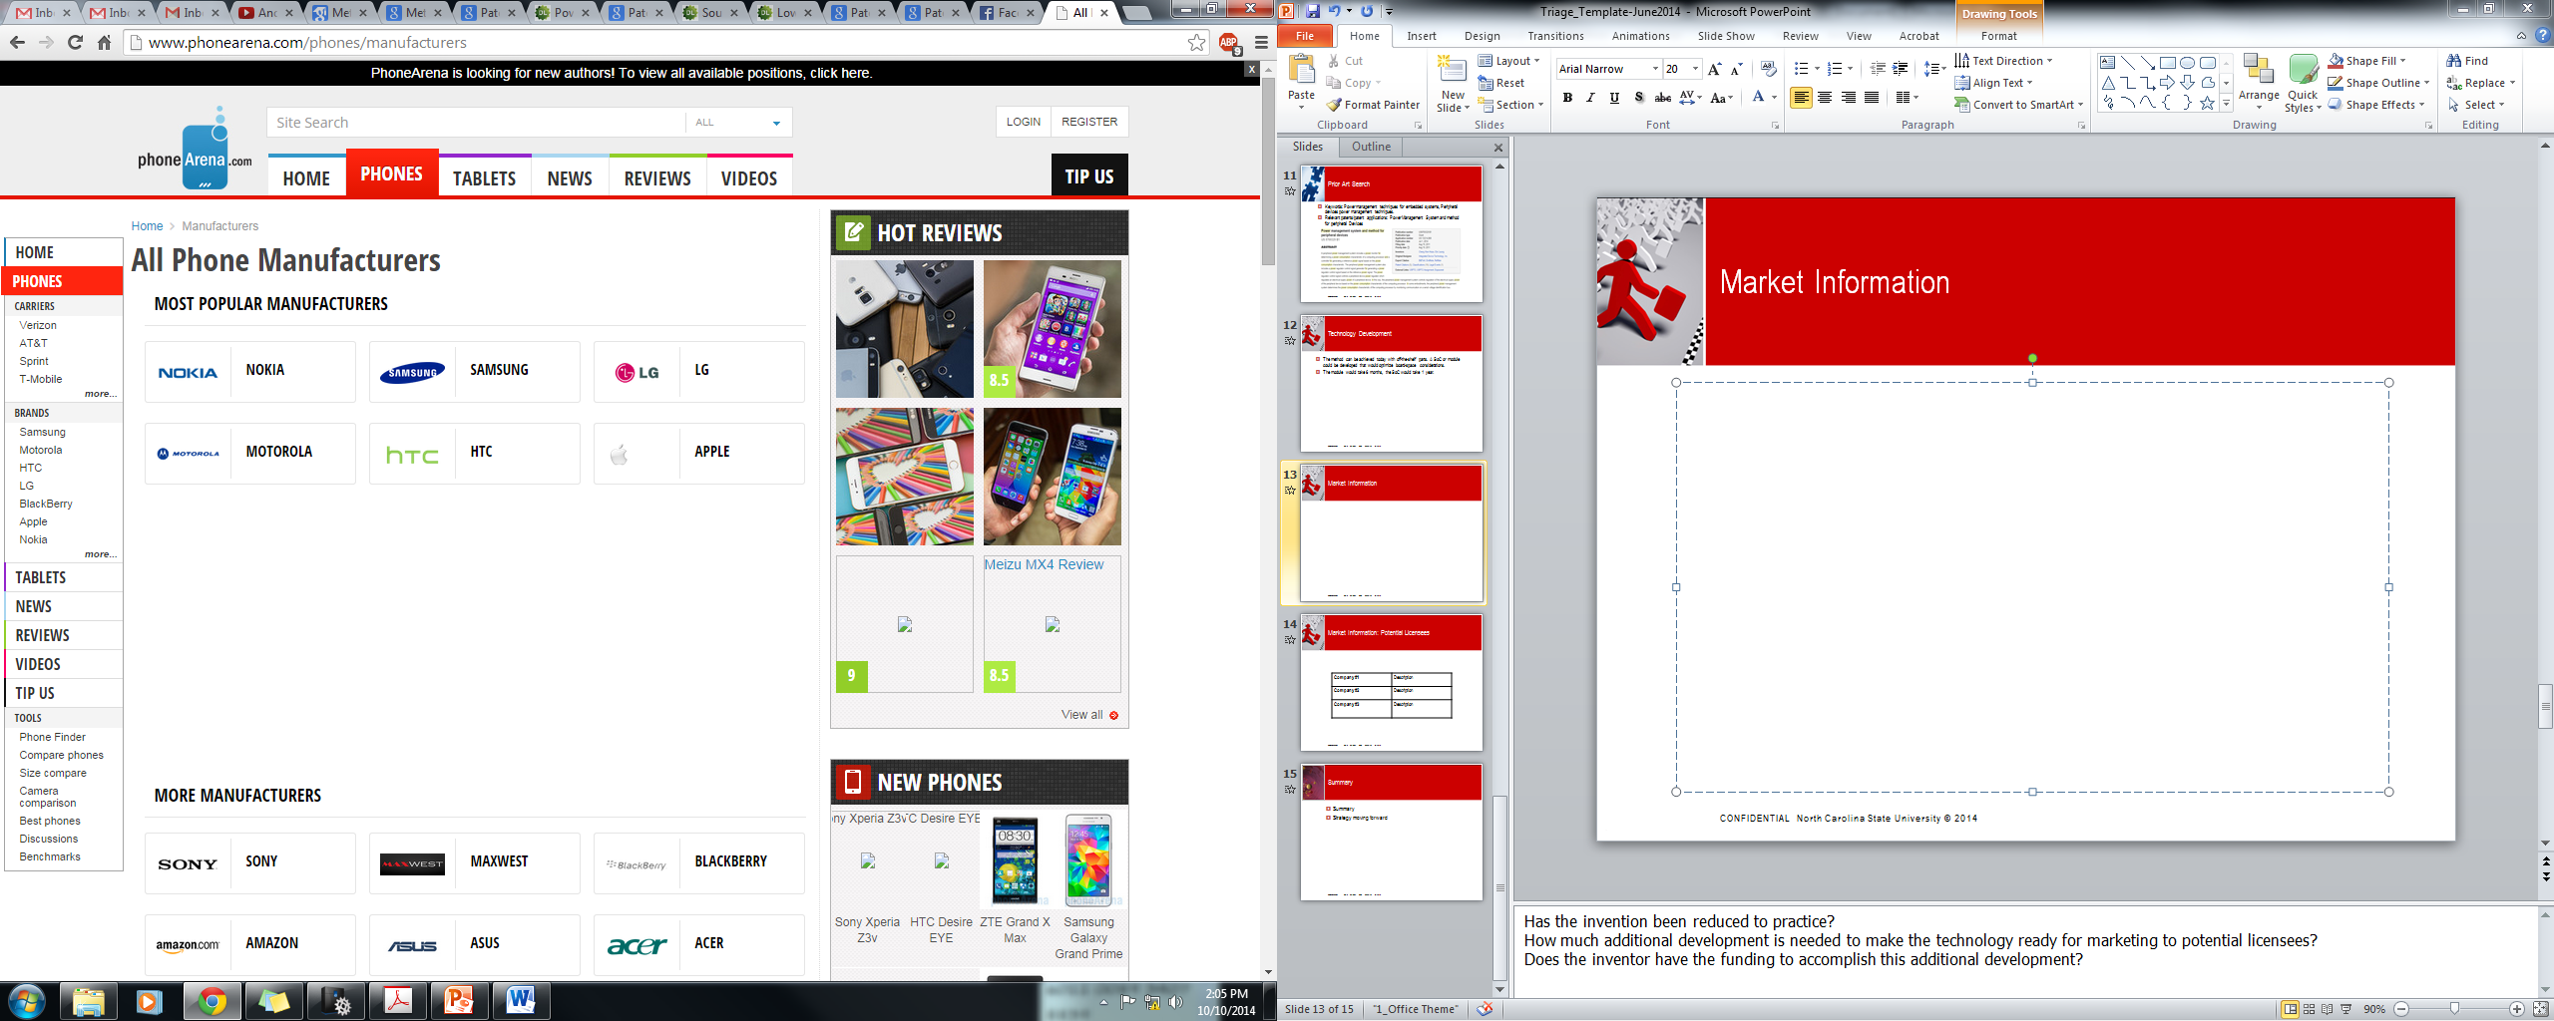



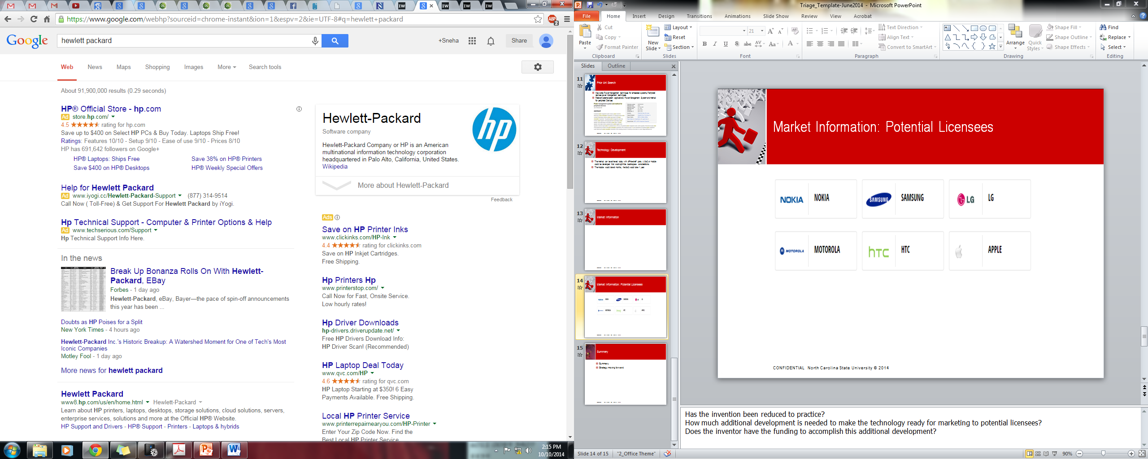
Market Information: Potential Licensees
^{CONFIDENTIAL} North Carolina State University © 2014
Notes:
Has the invention been reduced to practice?
How much additional development is needed to make the technology ready for marketing to potential licensees?
Does the inventor have the funding to accomplish this additional development?

Slide 17
Executive Summary
This invention is designed to have minimal impact on CPU utilization through the use of peripheral power profiles (PPP) which designate an ideal voltage on a per-state basis.
This method is demonstrated on common peripherals and have found energy savings of up to 40%.
The method is applicable immediately with off-the-shelf parts, but will require the addition of a separate power supply for peripheral devices.
Some concerns about prior art.
Strategy: Accept management, engage with Elster Group to determine obligations, market non-confidentially for three months to gauge industry interest.

